Slide 1
Chirurgia del tumore prostatico ad alto rischio e oligometastatico
Gianfranco Savoca
U.O.C. Urologia ARNAS Civico Palermo

Slide 2
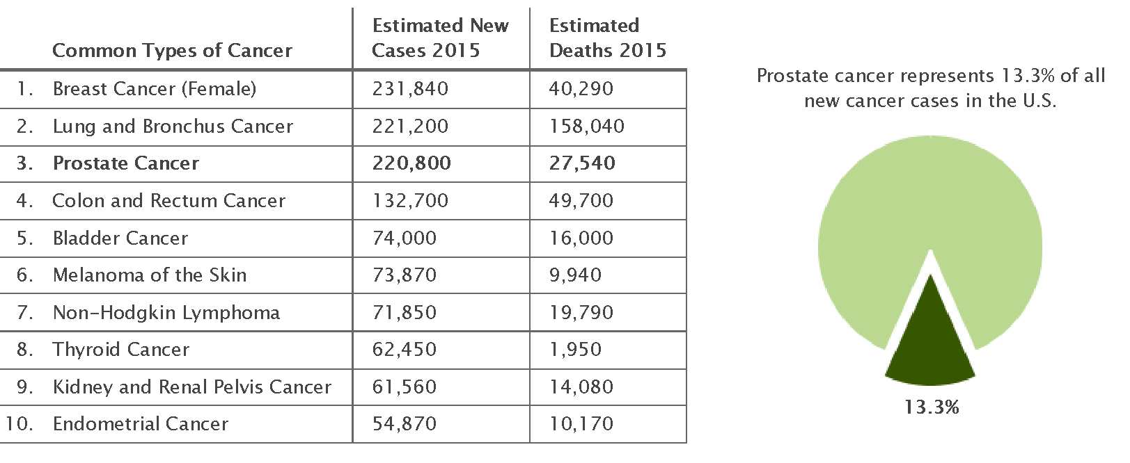
Pca is the second most frequently diagnosed cancer in men and the fifth leading cause of death worldwide
Surveillance Epidemiology and End Results Program. SEER 2015

Slide 3
High-Risk: far for being uniform definition
“At present the exact definition remains controversial.
This represents a critical barrier for patients counseling, comparation of treatment outcomes and the design of randomized trials.”
⟹ Potential role of biomakers in HR Pca

Slide 13
Studio retrospettivo su 315 Pts (PCA pN1)
Trattamento con Radical Prostatectomy + Extended Pelvic Linphonode Dissection (EPLND) (2000-2012)
Follow-up medio: 63.1 mesi
Analisi multivariata

Slide 14
CSS rate ↑ con aumento N° linfonodi rimossi
aRT ↑ CSS in questa categoria di PTS

Slide 15
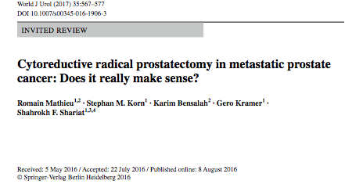

Slide 16
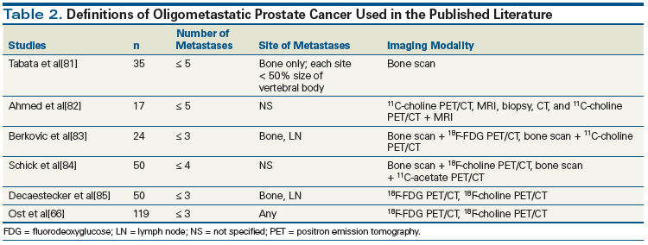

Slide 17
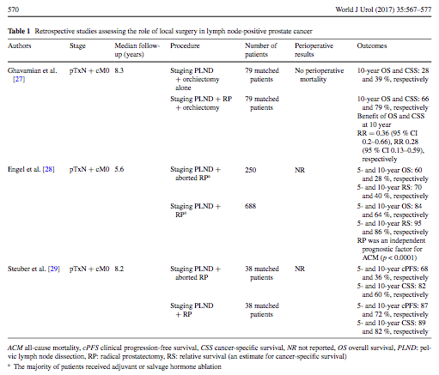

Slide 18
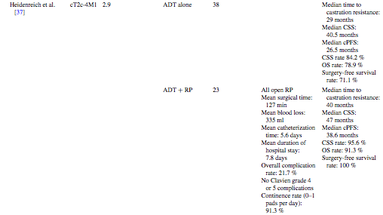
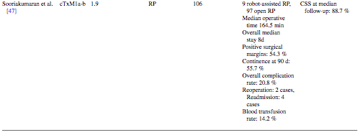

Slide 19
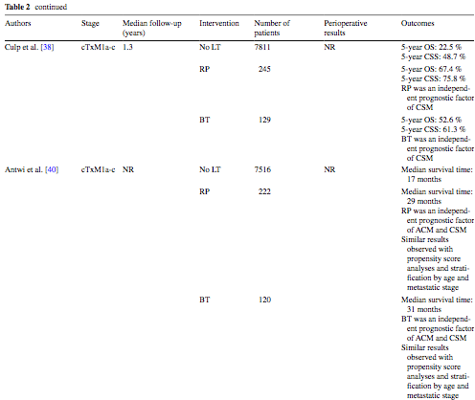

Slide 20
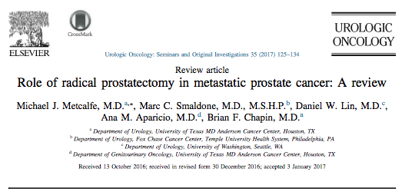

Slide 21
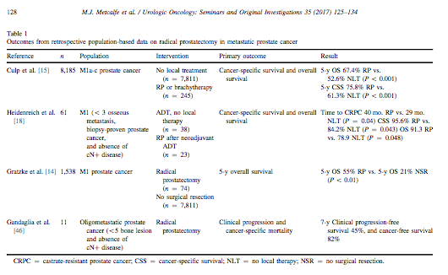

Slide 22
Progression free survival
45%
Cancer free survival
82%

Slide 23
Conclusions:
Depending on the classification system used, of patients with newly diagnosed prostate cancer have high risk disease; outcomes are heterogeneous among this group and prognoses are not always poor
Without clear evidence of superiority, radiation therapy combined with androgen deprivation therapy (ADT) has become the standard-of-care treatment for patients with high-risk disease; however, increasingly patients are initially treated surgically as part of multimodal therapy, has comparable efficacy to radiotherapy with ADT; therefore, primary surgery, with or without adjuvant radiotherapy, is a viable treatment option

Slide 24
Conclusions:
Surgery enables accurate histopathological assessment, local disease control and potentially reduces the risk of metastasis; concomitant extended lymphadenectomy might improves survival and identify patients in whom immediate ADT is indicated
Downstaging and downgrading of tumours in a substantial proportion of patients suggest that they would have been overtreated if radiotherapy and ADT were used
A multimodal approach to therapy including surgery, radiotherapy, and neoadjuvant an/or adjuvant ADT should be offered to men with high-risk prostate cancer, but the optimal protocols remain to be determined

